Slide 1
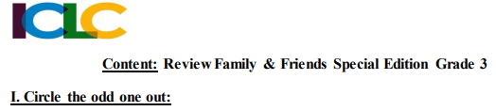
Bao
RIGHT
WRONG
WRONG

Slide 2
Bao
WRONG
WRONG
RIGHT

Slide 3
Bao
RIGHT
WRONG
WRONG

Slide 4
Bao
WRONG
WRONG
RIGHT

Slide 5
Bao
WRONG
WRONG
RIGHT

Slide 6
Bao
RIGHT
WRONG
WRONG

Slide 7
Bao
WRONG
RIGHT
WRONG

Slide 8
Bao
RIGHT
WRONG
WRONG

Slide 9
Bao
WRONG
WRONG
RIGHT

Slide 10
Bao
RIGHT
WRONG
WRONG

Slide 11
Bao
RIGHT
WRONG
WRONG

Slide 12




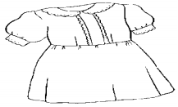




RIGHT
WRONG
WRONG
WRONG
WRONG
WRONG
WRONG

Slide 13

WRONG
WRONG
WRONG
WRONG
WRONG
WRONG
RIGHT

Slide 14
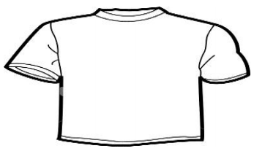
RIGHT
WRONG
WRONG
WRONG
WRONG
WRONG
WRONG

Slide 15
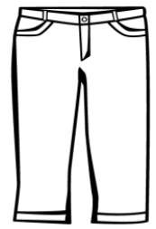
WRONG
WRONG
WRONG
WRONG
WRONG
WRONG
RIGHT

Slide 16
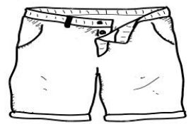
WRONG
WRONG
WRONG
WRONG
WRONG
RIGHT
WRONG

Slide 17
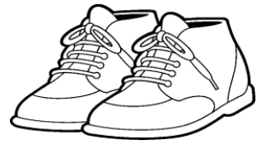
RIGHT
WRONG
WRONG
WRONG
WRONG
WRONG
WRONG

Slide 18
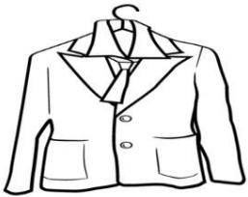
WRONG
WRONG
WRONG
WRONG
WRONG
WRONG
RIGHT

Slide 19
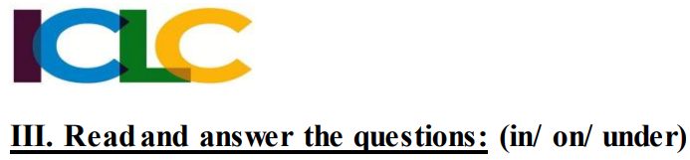
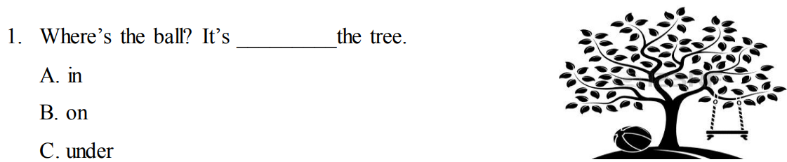
WRONG
Bao
WRONG
RIGHT

Slide 20
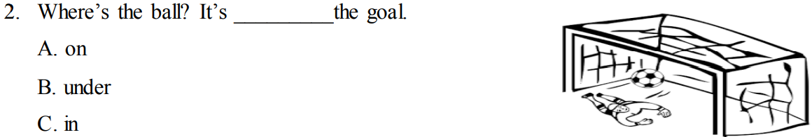
WRONG
Bao
WRONG
RIGHT

Slide 21
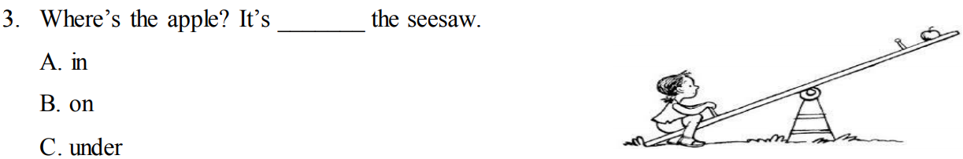
WRONG
Bao
RIGHT
WRONG

Slide 22
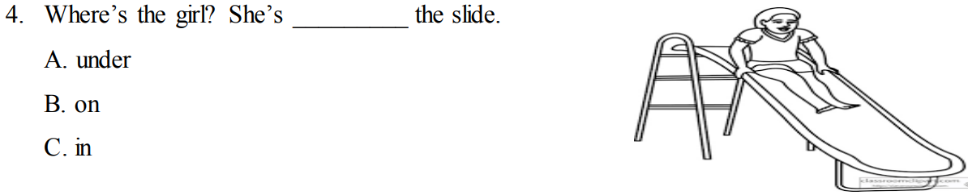
WRONG
Bao
RIGHT
WRONG

